Slide 1
Implementing Conversational AI
-Presentation by
Group 05

Slide 2




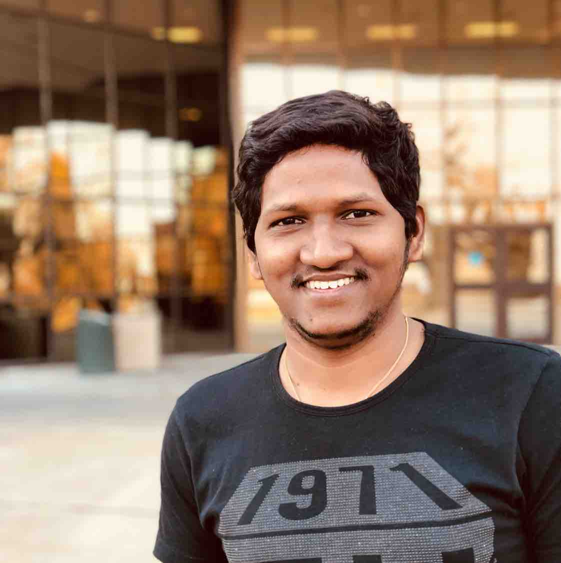
Team Members:
Santosh Sekhar Muchkur Bogarajula
Lakshmi Seshu Kalvakuri
Shivani Busireddy
Srimai Reddy Yanala
Vijay Tupakula
Lakshmi Seshu

Slide 3
Contents:
What is Conversational AI?
What fueled the rise of conversational AI?
Scope of Conversational AI
Most Trending AI device Technologies
Technologies Behind Conversational AI
Why Conversational AI?
Live Demo
Lakshmi Seshu

Slide 4

What is conversational AI...?
Use of messaging apps, speech-based assistants and chatbots to automate communication and create personalized customer experiences at scale.
Lakshmi Seshu
Image source: https://cdn-images-1.medium.com/max/918/1*avckxHOb81Zt-DueKRzxMQ.png

Slide 5
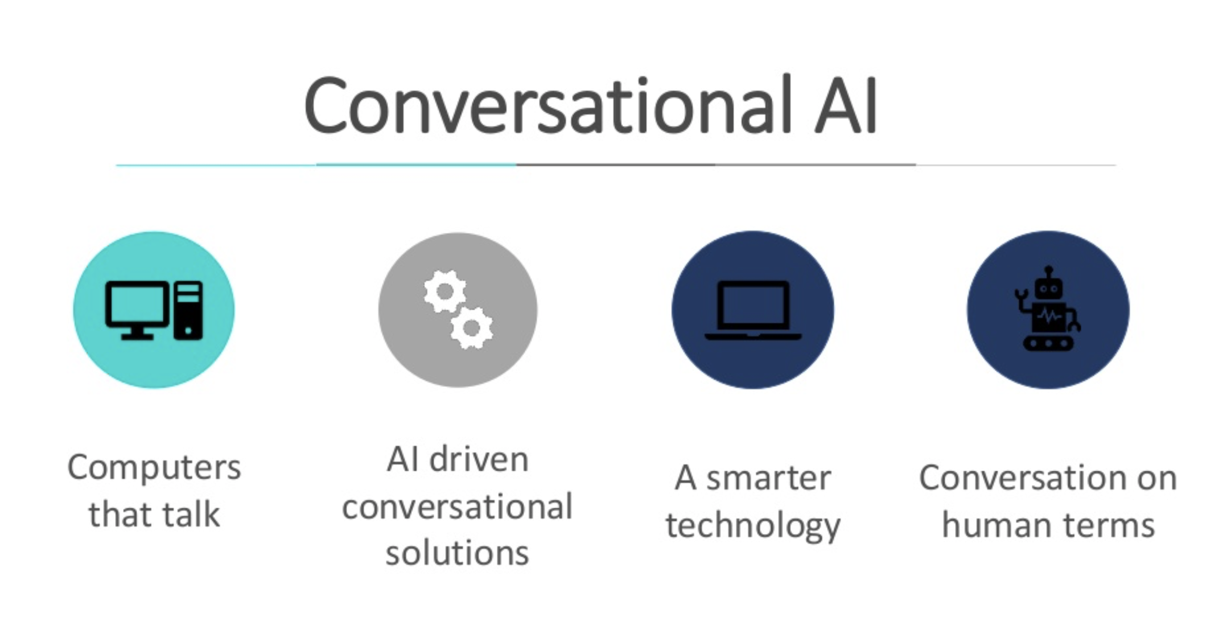
Lakshmi Seshu

Slide 6
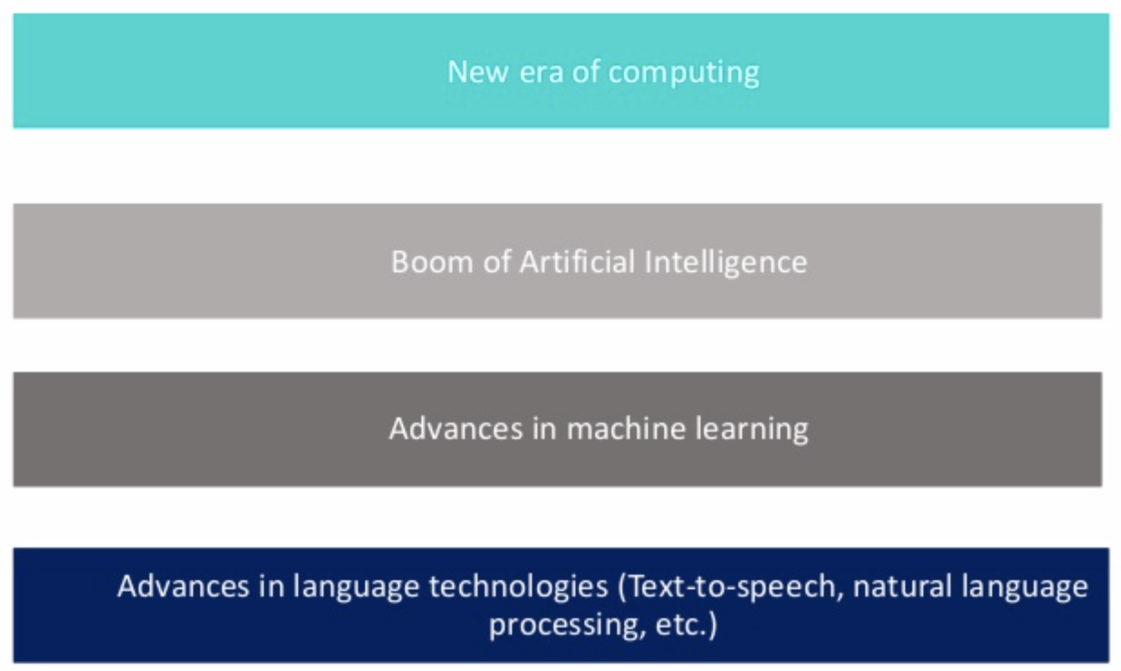
What fueled the rise of conversational AI?
Santosh Sekhar

Slide 7
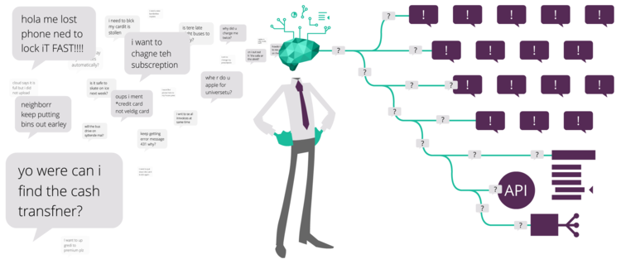
Image source: https://static1.squarespace.com/static/5a82e68c4c326d50016f26b5/t/5bc6f419f9619ab938278cf6/1539765285109/Six+ways.png?format=750w
Santosh Sekhar

Slide 8
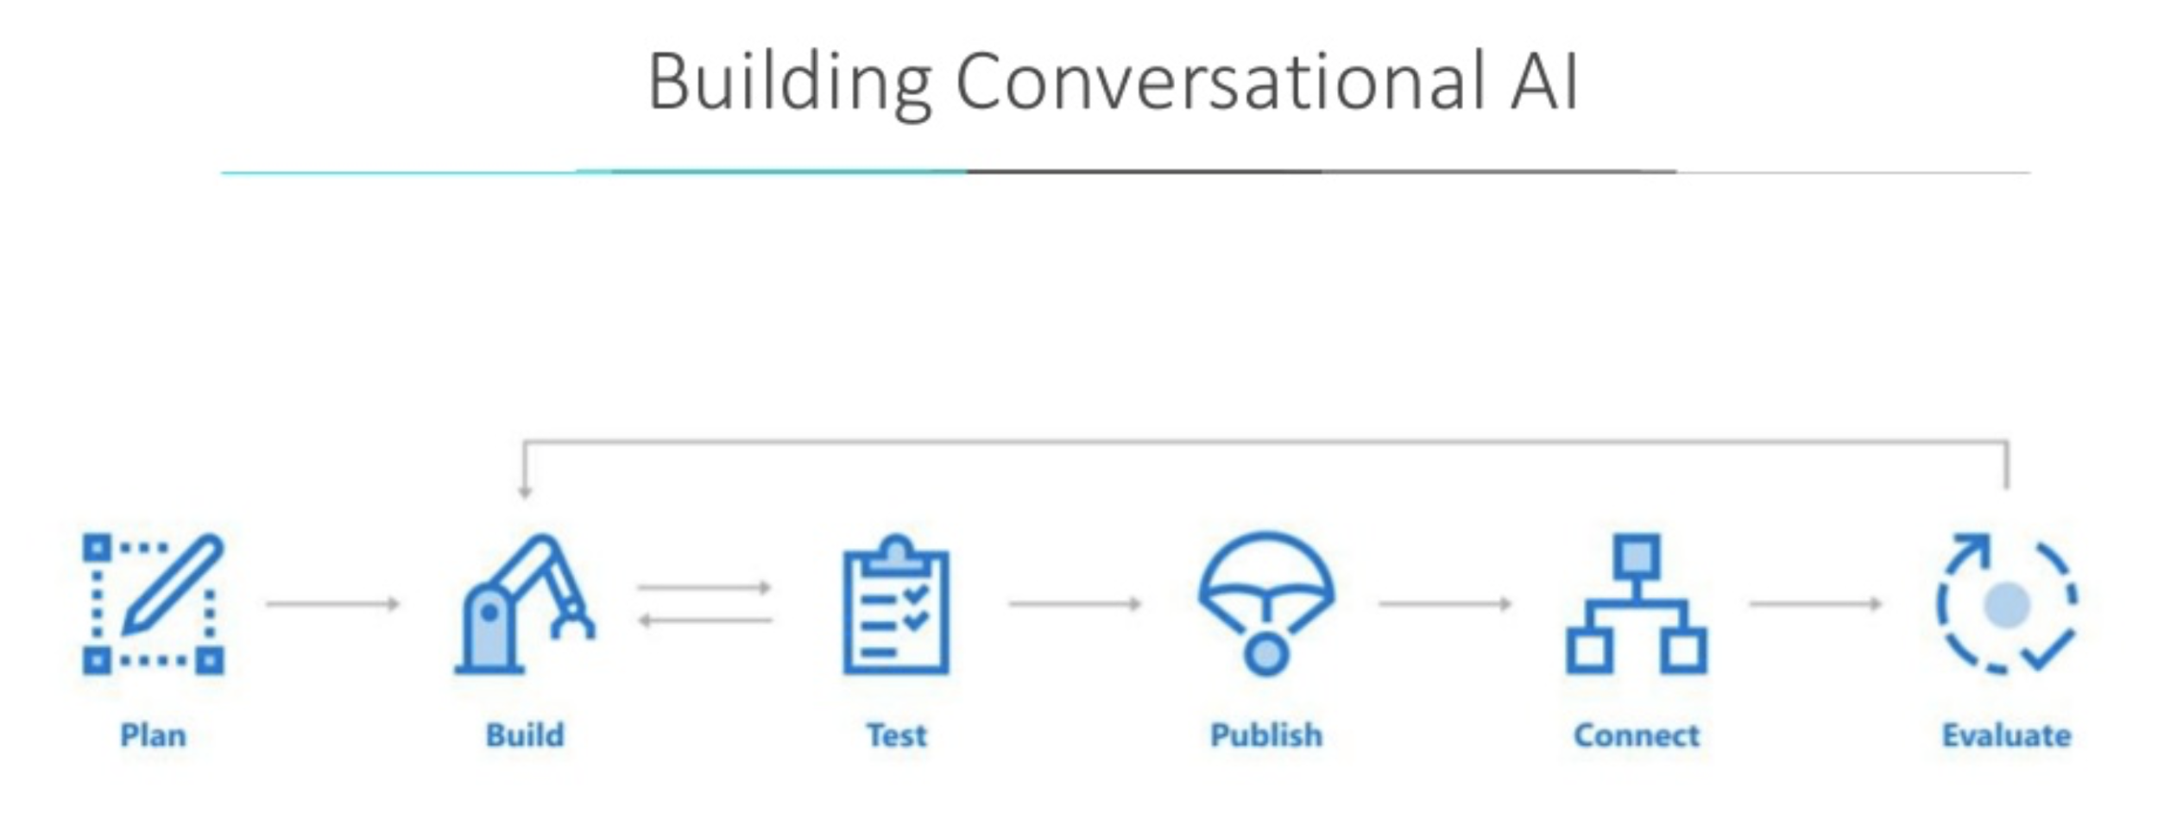
Image source: https://raw.githubusercontent.com/Microsoft/AI/master/docs/media/virtualassistant-diagram.jpg
Santosh Sekhar

Slide 9
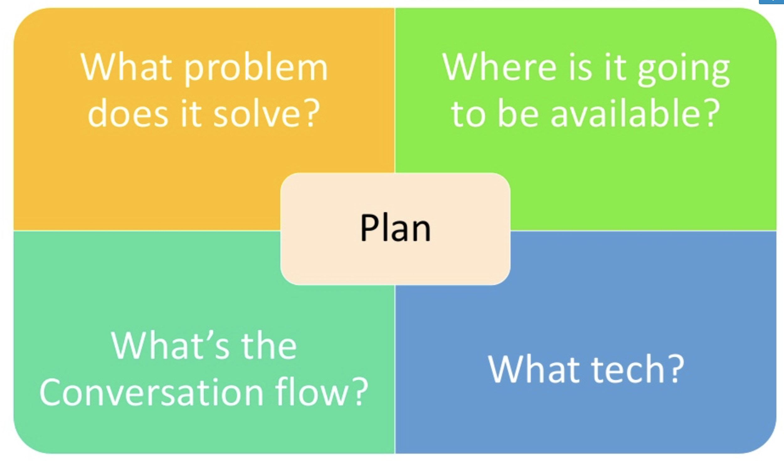
Santosh Sekhar

Slide 10

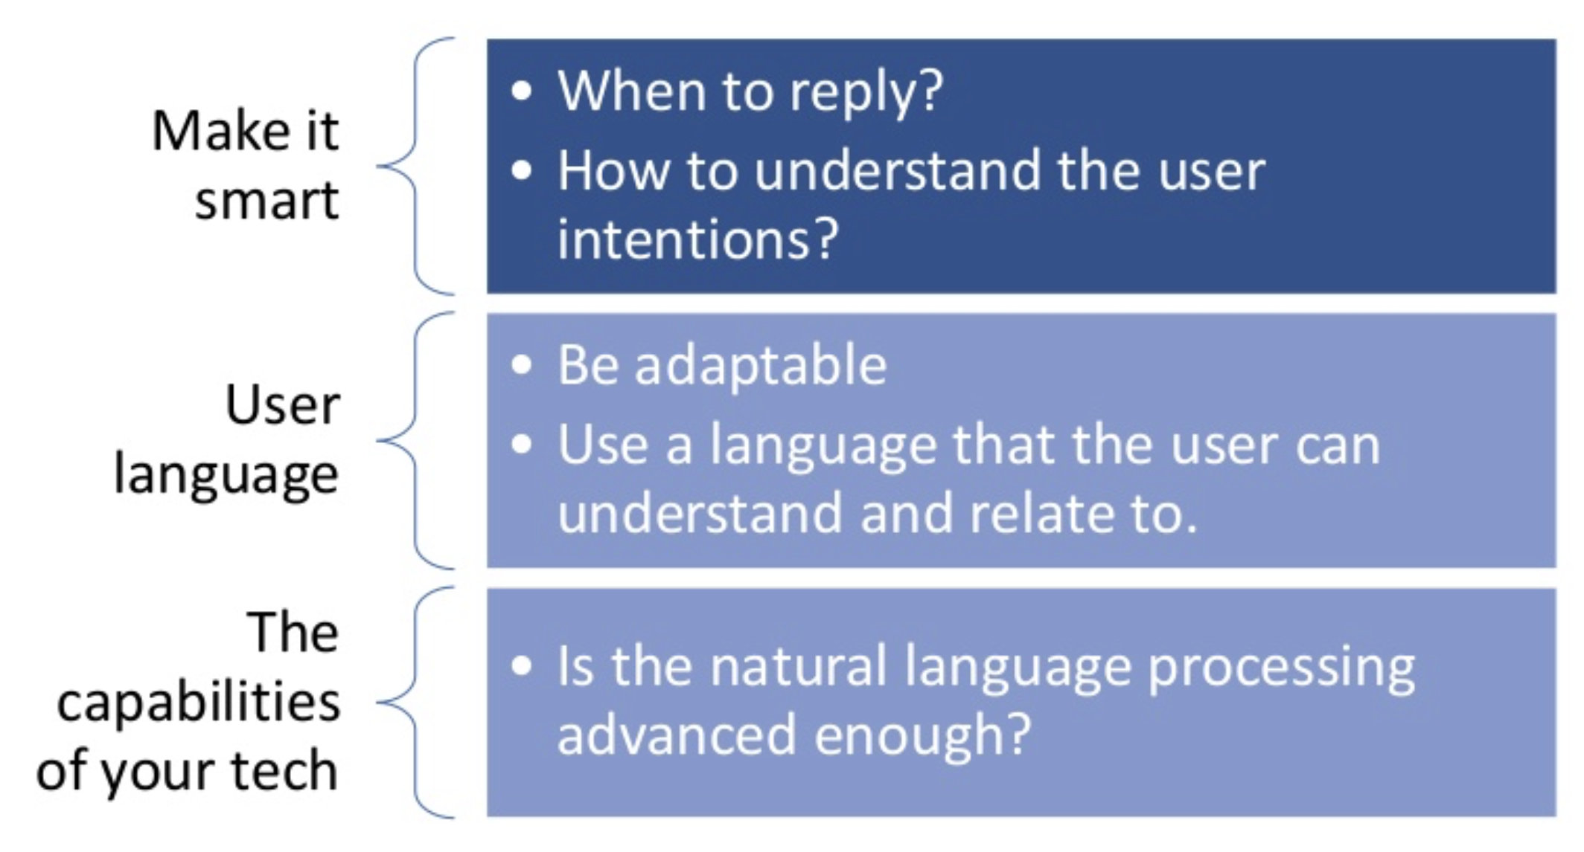
Things to be considered...
Image source: https://cdn.shopify.com/s/files/1/1061/1924/products/2_large.png?v=1544200552
Shivani Reddy

Slide 11
Scope of AI
Virtual assistants can fill loneliness in one’s life!
Can be one’s entertainment system
Can be one’s remote control
HR Chatbots for employee onboarding
The scope of Chatbots in banking
Bots help eCommerce evolve
Shivani Reddy

Slide 12

Scope of conversational AI
Shivani Reddy

Slide 13

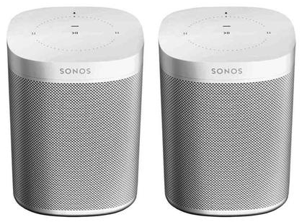
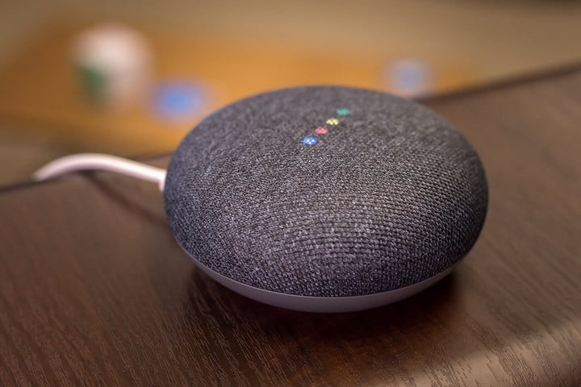
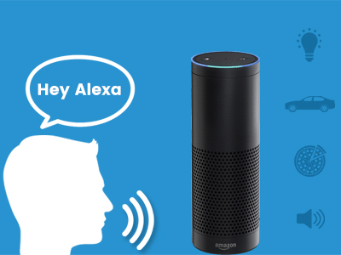
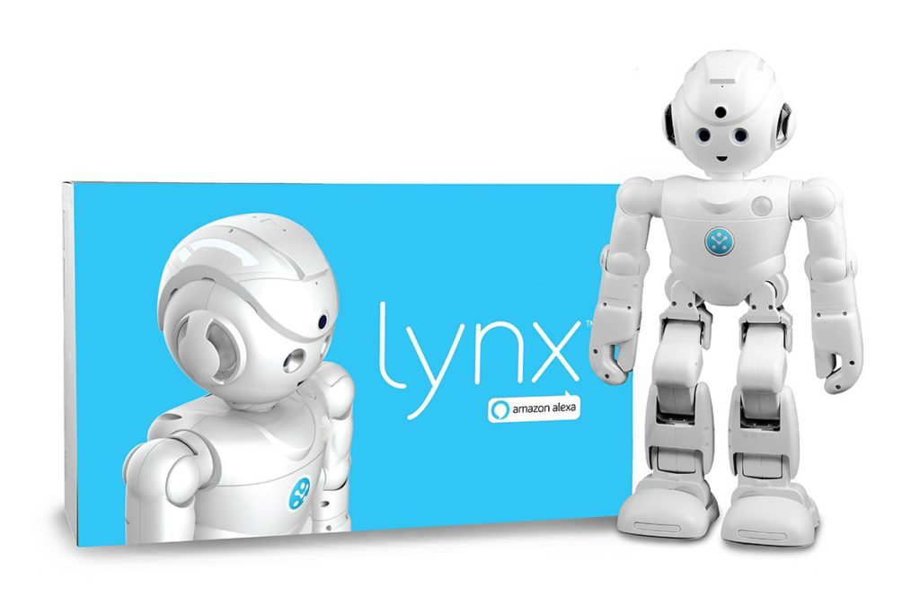
Most trending AI device technologies
Image source: https://static.seekingalpha.com/uploads/2017/1/30/47535815-14858323502251425_origin.jpg
Image source: https://images-na.ssl-images-amazon.com/images/I/81Sw1HOJRLL._SX425_.jpg
Image source: https://icdn2.digitaltrends.com/image/poster-for-5718044378001-720x720.jpg
Image source: https://cdn.vox-cdn.com/thumbor/aisDiXUogvfA9MwqTuJ_SzI5kkg=/0x0:1200x790/1200x800/filters:focal(504x299:696x491)/cdn.vox-cdn.com/uploads/chorus_image/image/57684283/61szJyIzjKL._SL1200_.0.jpg
Image source: https://cdn.dribbble.com/users/1726280/screenshots/5614445/revamp-alexa-skill-development.gif
Shivani Reddy

Slide 14
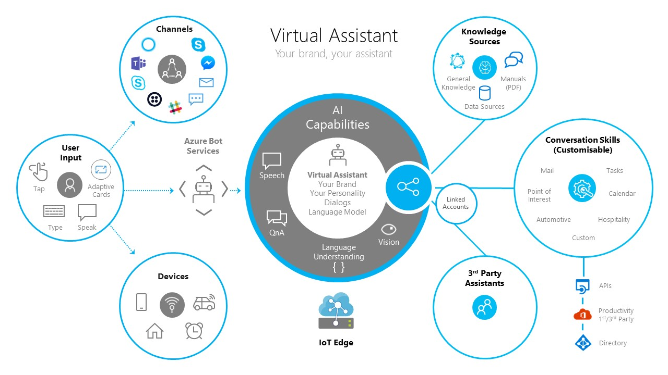
Image source: https://raw.githubusercontent.com/Microsoft/AI/master/docs/media/virtualassistant-diagram.jpg
Srimai Reddy

Slide 15
Technology behind conversational AI
The AI behind the conversational functionality of such a platform can range from complex techniques like Machine Learning and Deep Learning to surface “layers” of the platform that rely on simple if-else chains to guide users through a flowchart.
Layer 1: Handle simpler exchanges through pre-built conversational flows that anticipate numerous possible cases.
Layer 2: A generative and “neural conversation model” that we use helps us cater to queries which the bot is usually not trained on.
Layer 3: Default to a Small Talk module that can handle random open-ended queries about the weather, etc.
Srimai Reddy

Slide 16
Why conversational AI?
Delightful User experience
Its timely i.e. 24*7
Humans like to do things with less effort
Its engaging and conversational
Scalability: infinite
Easy communication
Talks only what is necessary and when asked for
Srimai Reddy

Slide 17

Image source: https://www.promisec.com/wp-content/uploads/2016/09/livedemo-1.png
Vijay Tupakula

Slide 18

Questions...
Image source: https://static1.squarespace.com/static/585c5b5a9de4bb6fe48becb4/t/589bda1e20099ecd1ba5027a/1486608931886/
ChatBots

Slide 19
References
https://developer.amazon.com/alexa-skills-kit/conversational-ai
https://www.slideshare.net/rabebothmani/building-conversational-ai-133402381?qid=2820e335-d889-46ff-b492-176de489e0ef&v=&b=&from_search=2
https://www.iotforall.com/what-is-conversational-ai/
https://chatbotslife.com/https-medium-com-hellohaptik-understanding-conversational-ai-what-where-how-you-can-use-bots-a5df897886f9
ChatBots

Slide 20

Have a great Day.. :)
ChatBots
Image source: https://artiez.co.uk/wp-content/uploads/2018/12/Thank-You-Free-PNG-Image.png

